Slide 1
Ministry of Science and Higher Education of the Russian Federation
Federal State Autonomous Educational Institution of Higher Education
TOMSK STATE UNIVERSITY OF CONTROL SYSTEMS AND RADIOELECTRONICS (TUSUR)
Bill Gates
Completed by: student of group 435-M1 Andreev Dmitry
Supervisor : Senior Lecturer, Department of Foreign Languages
Tereshchenko Anna Vasilievna
Tomsk 2026

Slide 2


Content
Biography
First steps in IT
Start Microsoft
Conclusion
Bibliography

Slide 3
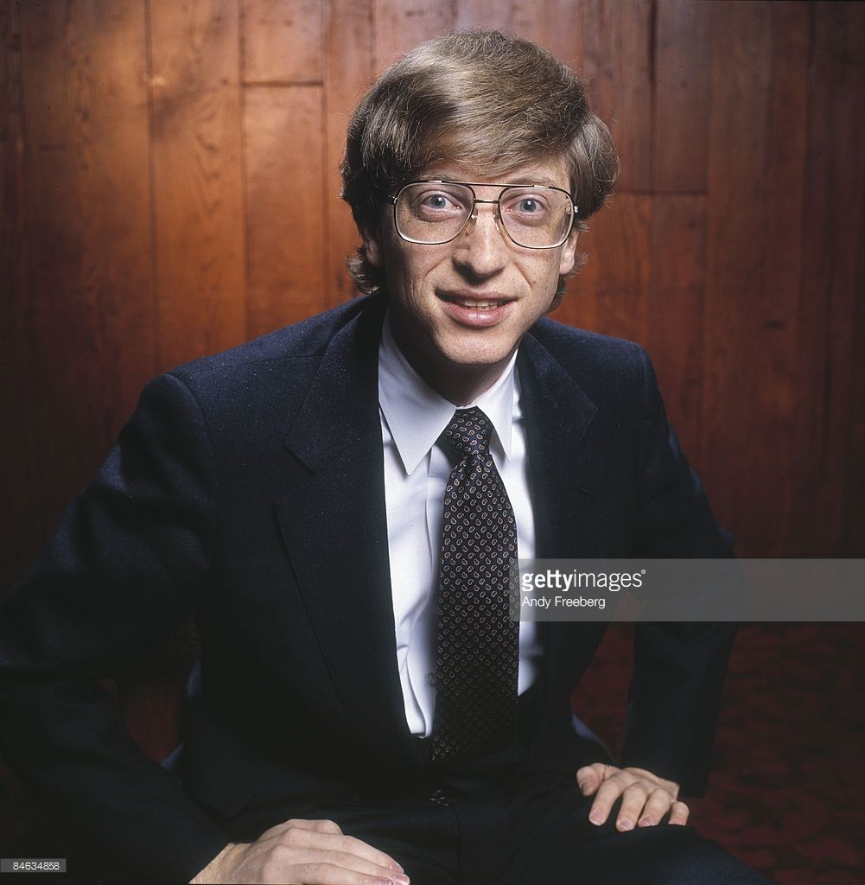
Biography
William Henry Gates III (Bill Gates), born October 28, 1955, in Seattle, is a prominent businessman, computer magnate, and founder and owner of Microsoft.

Slide 4
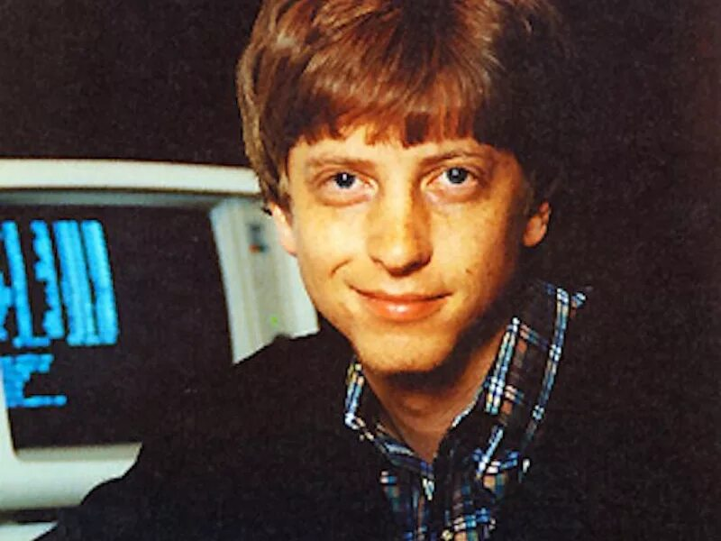
First steps in IT
He created his first computer program at age 13. He loves cars, motorboats, and poker. He never ate at home because he didn't want to waste time cooking. He was the firstborn and only son of a prominent lawyer.

Slide 5
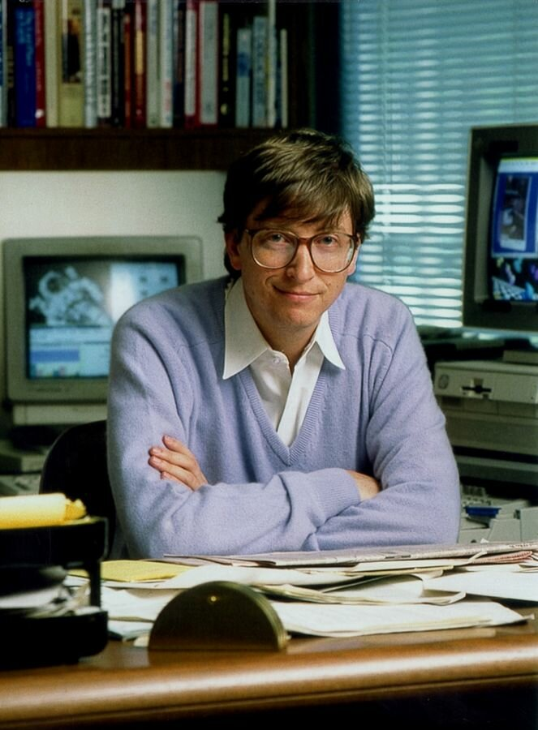
First steps in IT
In 9th grade, Gates was an excellent student and ranked among the top ten students in the country on math tests.
In 10th grade, he taught computer literacy and wrote a program to create a school schedule.
This earned him $4,200.
- After graduating from high school, Gates became an independent entrepreneur and founded a company that analyzed urban traffic.

Slide 6
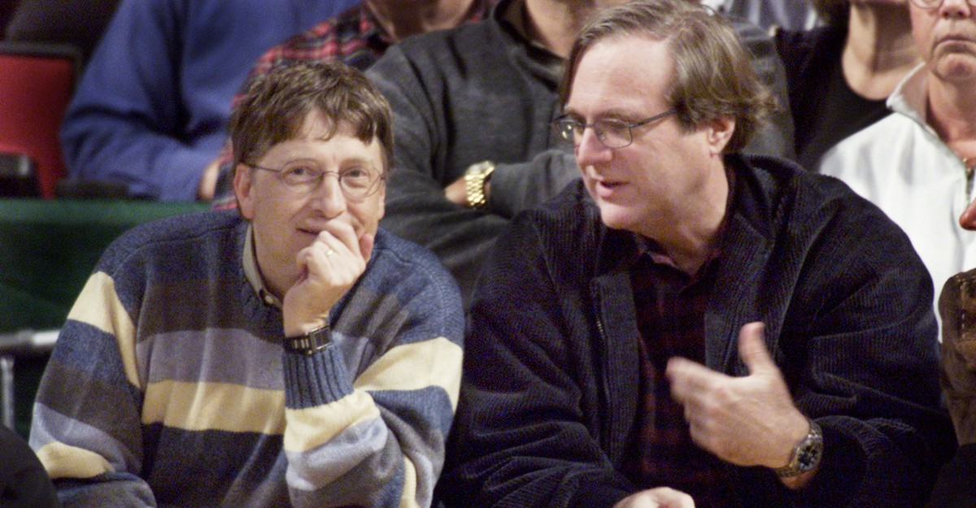
Start Microsoft
In 1974, Bill Gates and Paul Allen contacted M.I.T.S., offering software (a version of BASIC) for their Altair 8800 computer.
This option satisfied the managers, who offered the young men work on writing programming languages. The couple moved to New Mexico, where the history of Microsoft began.

Slide 7
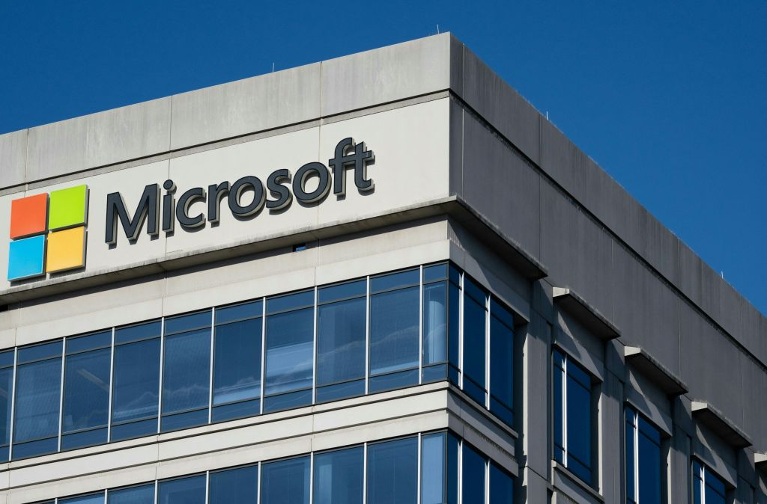
Start Microsoft
That same year, at Gates's initiative, they began selling licenses for the software they had developed. This made it possible to provide PCs with new operating systems and programming languages. Thanks to this innovation, their company's revenues increased significantly.
As a result of the team's coordinated work, in 1977 they were able to introduce a new operating system called Microsoft Fortran.

Slide 8
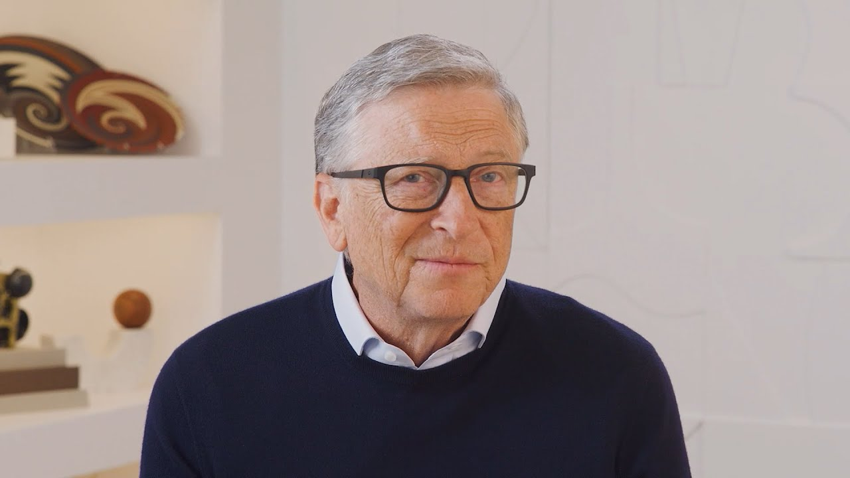
Conclusion
In conclusion, it is worth saying that Bill Gates truly had a huge impact on the development of technology, and his legacy will live on for a very, very long time.

Slide 9
Bibliography
1) Bill Gates Biography. [Electronic resource]. Wikipedia. URL: https://en.wikipedia.org/wiki/Bill_Gates
2) Bill Gates biography, photos, career, personal life. [Electronic resource]. RBC Radio - the latest news today on RBC.Ru. URL: https://www.rbc.ru/person/619b8e469a7947b325ff3ec6
3) Great Minds of the IT World. Bill Gates / Habr. [Electronic resource]. Habr.
URL: https://habr.com/ru/companies/sberbank/articles/897950/
4) Bill Gates: Biography of the Microsoft Co-Founder. [Electronic resource]. Mail.ru News. URL: https://news.mail.ru/card/692/.
5) Bill Gates - Ruwiki: The Internet Encyclopedia. [Electronic resource]. RUVIKI — a new Russian online encyclopedia. URL: https://ru.ruwiki.ru/wiki/Гейтс,_Билл
6) Bill Gates: Biography of the Programmer, Billionaire, and Founder of Microsoft. [Electronic resource]. Skillbox Media. URL: https://skillbox.ru/media/code/bill-geyts-kak-botanik-sozdal-microsoft-i-unichtozhal-konkurentov/
7) Biography of Bill Gates, the founder of Microsoft. [Electronic resource]. Brobank. URL: https://brobank.ru/bill-gejts/

